Slide 1

Bank Marketing Data Analysis
Exploratory Data Analysis using Python

Slide 2

Project Overview
This project applies Exploratory Data Analysis (EDA) to a real-world bank marketing dataset, uncovering customer behaviour patterns and the key factors that drive term deposit subscription decisions.
Understand
Analyse
Prepare
Decode dataset structure and customer demographics
Extract meaningful patterns through visualisation
Ready the data for future machine learning models

Slide 3


BUSINESS PROBLEM
Why Do Some Customers Subscribe — and Others Don't?
Banks invest heavily in marketing campaigns to promote term deposits, yet response rates remain low. This project analyses customer data to answer three core questions:
Which factors influence subscription decisions?
What patterns exist in customer behaviour?
How effective are current campaign strategies?

Slide 4
Project Objectives
Six clearly defined objectives guided the analysis from raw data to actionable insight.
1
2
Understand Structure
Assess Quality
Inspect data types, shape, and feature definitions
Identify missing values and data inconsistencies
3
4
Analyse Target
Explore Relationships
Examine subscription distribution and class balance
Measure correlations across numerical features
5
6
Visualise Patterns
Enable Modelling
Surface insights through charts and heatmaps
Prepare a clean, structured dataset for ML pipelines

Slide 5
Dataset Description
Each row represents a unique customer record from a bank marketing campaign, spanning demographic, financial, and campaign-related attributes.
Customer Demographics
Financial Information
Campaign Information
Age
Job & Marital Status
Education Level
Account Balance
Housing Loan Status
Personal Loan Status
Contact Duration
Number of Contacts
Previous Campaign Outcomes

Slide 6




Tools & Technologies
The project was built entirely in Python, leveraging a modern data science stack for cleaning, analysis, and visualisation.
Python
Pandas & NumPy
Matplotlib & Seaborn
Jupyter Notebook
Core programming language
Data manipulation and numerical computation
Statistical charts and visual exploration
Interactive development environment

Slide 7
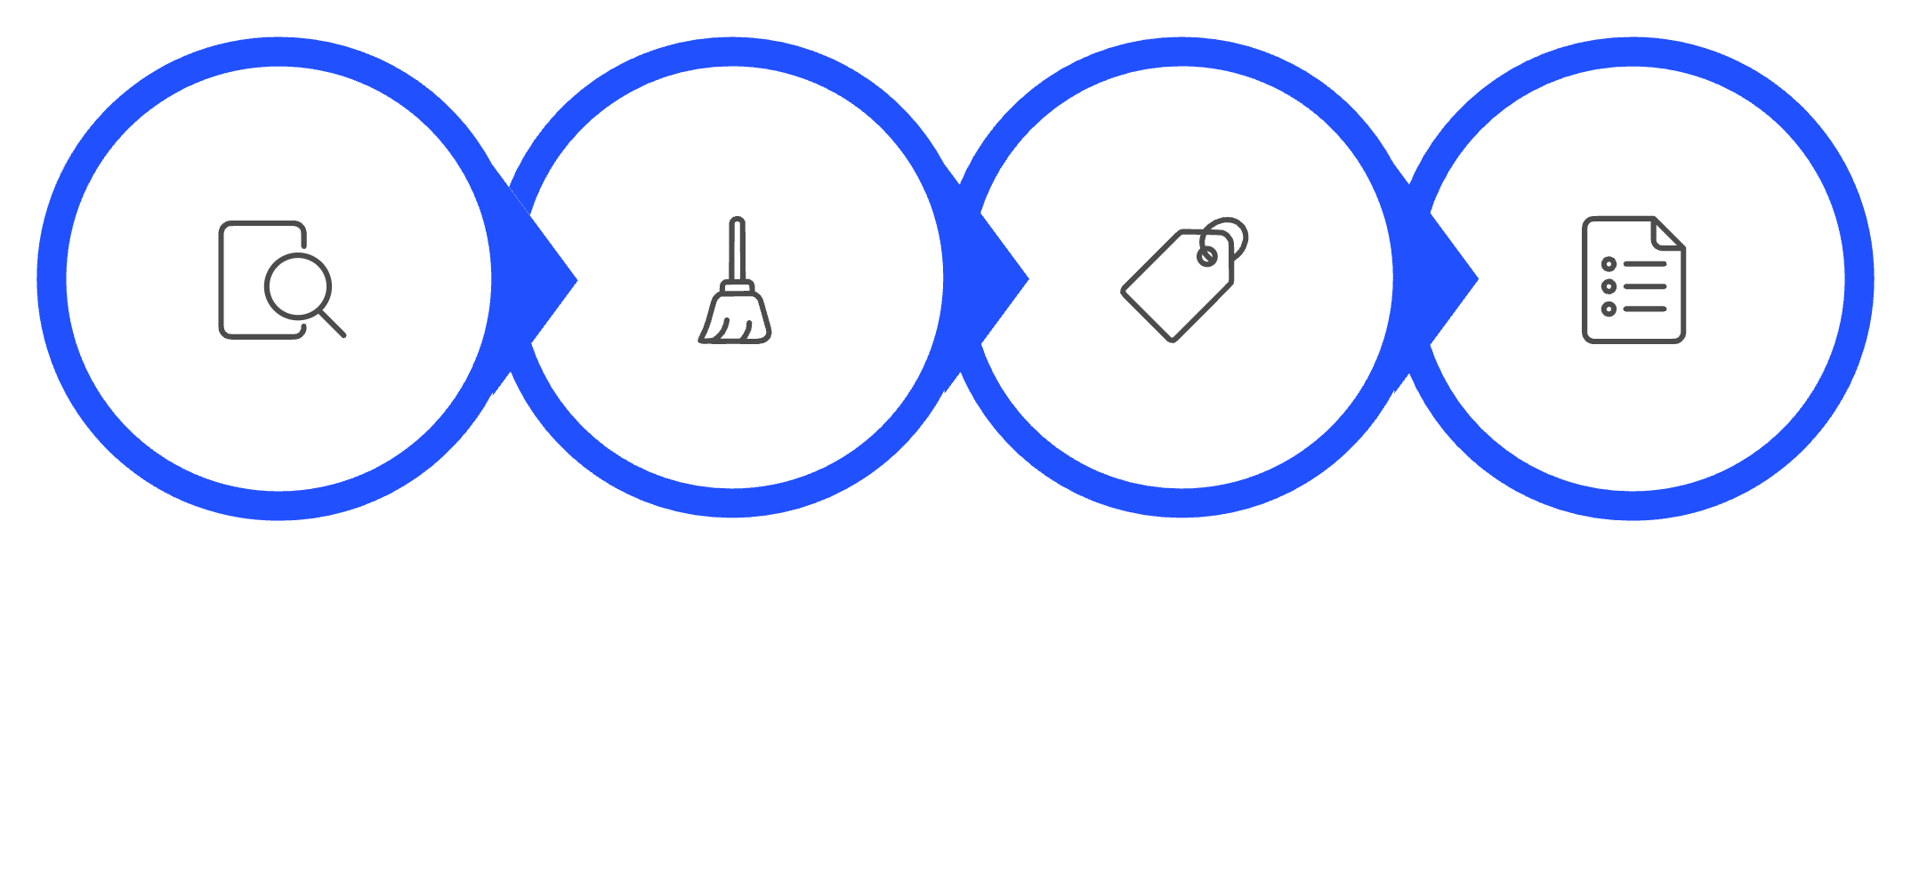
DATA PREPARATION
Laying the Foundation for Reliable Analysis
Before any analysis could begin, the dataset was rigorously prepared to ensure accuracy and consistency.
Inspect
Clean
Classify
Select
No Missing Values Found
Data Types Verified
Numerical Subset Selected
All features were complete, removing the need for imputation.
Categorical and numerical columns were correctly classified.
Relevant columns isolated for downstream correlation analysis.

Slide 8

Target Variable: Class Imbalance Uncovered
The target variable y captures whether a customer subscribed to a term deposit. Analysis revealed a significant class imbalance — a critical finding for any future predictive modelling work.
This imbalance means future ML models must account for bias using techniques such as oversampling, undersampling, or weighted classification.
Did Not Subscribe (No)·88%
·88%
·
Subscribed (Yes)·12%
·12%
·
~88%
~12%
Customers did not subscribe
Customers subscribed successfully

Slide 9

Key Insights from EDA
Contact Duration Matters Most
Longer call durations showed the strongest association with successful subscriptions — quality of engagement outweighs quantity.
Demographics Show Weak Direct Links
Age, job, and marital status alone are poor predictors. Subscription decisions are multi-dimensional, not demographic-driven.
Campaign Variables Carry More Signal
Number of contacts and previous campaign outcomes provided stronger predictive indicators than financial attributes.
Class Imbalance Requires Attention
The 88/12 split demands deliberate handling before training any classification model to avoid skewed predictions.

Slide 10

Skills Demonstrated & Next Steps
Skills Demonstrated
Future Scope
01
Feature Engineering
Data Cleaning
EDA
Create derived variables to improve signal strength
02
Encode Categorical Variables
Visualisation
Statistical Thinking
Apply label and one-hot encoding for ML readiness
03
Build Classification Models
Train and evaluate models to predict subscriptions
Python
Analytical Thinking
🔗 View the full project on GitHub: github.com/Ankurvashistha07

